Slide 1

SO₂ and Ash Products from EPIC Observations
Principal Investigator: Nickolay Krotkov (GSFC 614)
Co-Investigators: Brad Fisher (SSAI), Can Li (UMCP ESSIC), Pawan K. Bhartia (NASA GSFC), Simon Carn (MTU), Eric Hughes (AOSC/UMCP);
Collaborators: Omar Torres (NASA GSFC), Fred Prata (NILU Norway), Steve Taylor (SSAI);
Simulated volcanic SO₂ cloud from 2006 Soufriere Hills eruption
We proposed to implement our BUV algorithms previously developed for TOMS, OMI and OMPS to enable SO₂ and Ash Index (AI) products from EPIC UV observations to demonstrate time resolved estimates of transient volcanic SO₂ and ash clouds
Notes:
Fig. 1. Simulation of the view of the Earth from DSCOVR’s EPIC sunrise to sunset observations showing that EPIC will enable unprecedented high-frequency coverage of volcanic plumes. In this example, a volcanic SO2 cloud from May 2006 Soufriere Hills eruption (Montserrat, West Indies) drifting across the Pacific, is captured seven times in one day by EPIC, assuming a 90 minute interval (22.5o rotation). The SO2 cloud is simulated based on actual OMI Level 3 0.25°×0.25° gridded data (about the same resolution as EPIC) with up to 15 DU of column SO₂. The SO₂ cloud is shown as the light colored feature against blue ocean background, after the plume had drifted eastward to a location just north of the equatorial Pacific.

Slide 2

Outline
Background
SO₂ Algorithm
Retrieved Parameters (SO₂, O₃, R and dRdλ)
SO₂ Plume Evolution
Comparisons with Other Satellites
L1B Issues
Product Status
New Science Questions

Slide 3
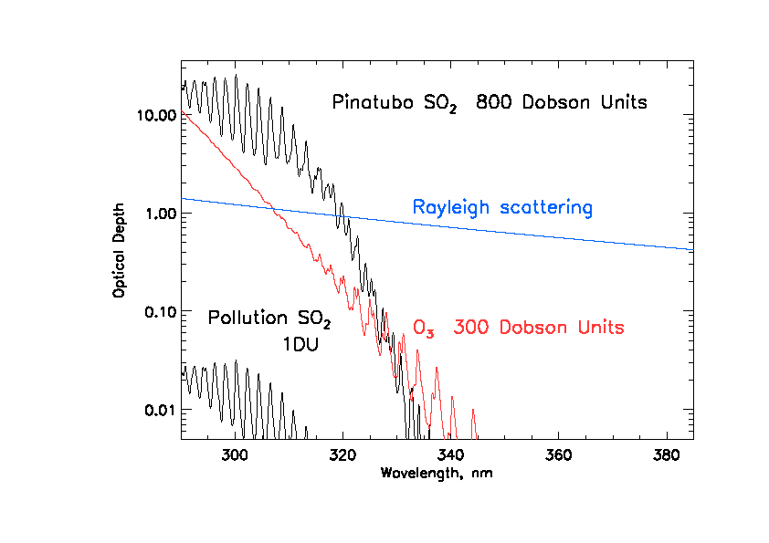
EPIC UV channels
SO₂ O₃ AI = N_{340m} – N_{340calc}(LER₃₈₈)
317
325
340
388
Notes:
Description of the DSCOVR/EPIC SO2 Algorithm PI: Nick Kroktov
The DSCOVR/EPIC volcanic SO₂ algorithm is a modified version of the heritage NASA Total Ozone Mapping Spectrometer (TOMS) 4-band algorithm, adapted to the EPIC wavelengths. The algorithm uses all four EPIC UV channels (centered at 317nm, 325nm, 340 nm, 388nm) to retrieve 4 parameters of the state vector (x): vertical column amounts of SO₂ (assuming 13km height) and total O₃, the Lambertian equivalent reflectivity at 388 nm (R), and its spectral dependence, dR/dλ. The algorithm relies on spectral differences in SO₂ and O₃ absorption cross sections to separate the two trace gases. SO₂ is more absorbing than O₃ at the shortest UV channel (317 nm), whereas O₃ is more absorbing at the longer channel (325nm).
The retrieval is performed iteratively for each EPIC pixel with SZA < 75º. It starts with the climatological profile of O₃ and zero SO₂ and first computes Lambertian equivalent scene Reflectivity (LER) at 388 nm (R). This parameter remains fixed during the iterations. The algorithm then retrieves adjustments to the state vector: Δx =[ΔSO_{2,} ΔO₃, Δ(dR/dλ)] by matching measured and calculated sun-normalized backscatterd UV (BUV) radiances at shorter spectral channels (317,325 and 340nm). The sensitivities (Jacobians) associated with linear perturbations in SO₂, O₃ and R are pre-computed for each UV spectral band and stored in look-up tables, which are numerically interpolated for EPIC viewing geometry and state vector values at each iteration. This algorithm appears to have adequate sensitivity to detect moderate to large volcanic eruptions from L1 Lagrange point.
EPIC channels shown in purple:
Major absorbing gases are :
Ozone (o3) always present; 90% in stratosphere; global average ~300DU;
317 – O3 and SO2
325 – ozone and SO2
SO2/O3 X section ratios are different at 317nm and 325nm allow separating O3 and So2 abundancies;

Slide 4
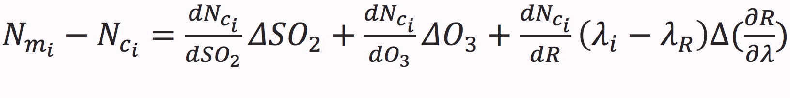
EPIC SO₂ Algorithm: Step 1
MS_SO2 uses 4 UV DSCOVR/EPIC channels at 317.5, 325, 340 and 388nm to retrieve state vector containing 4-parameters: SO₂, O₃, R(λ=388nm) and dR/dλ
N_{M}: Measured N= -100*log₁₀(I/F), N_{C}: Calculated N= -100*log₁₀ (I/F)
dN/dSO₂, dN/dO₃, dN/dR represent sensitivities of N vrt SO₂, O₃ and Reflectivity.
Compute Lambertian equivalent reflectivity (R) at λ_{R} = 388nm
Compute sensitivities, dN/dx, at 317, 325 and 340 nm for each of the retrieved parameters in (1) to form a 3 x 3 Jacobian matrix (K)
Invert K matrix to retrieve corrections Δx_{i}: ΔSO₂, ΔO₃ and Δ(dR/dλ)
Update state vector by iteration, where x_{i}=x_{i-1}+∆x_{i}
dR/dλ used to correct reflectivity at shorter channels: 317, 325 and 340nm
Notes:
Description of the DSCOVR/EPIC SO2 Algorithm PI: Nick Kroktov
The DSCOVR/EPIC volcanic SO₂ algorithm is a modified version of the heritage NASA Total Ozone Mapping Spectrometer (TOMS) 4-band algorithm, adapted to the EPIC wavelengths. The algorithm uses all four EPIC UV channels (centered at 317nm, 325nm, 340 nm, 388nm) to retrieve 4 parameters of the state vector (x): vertical column amounts of SO₂ (assuming 13km height) and total O₃, the Lambertian equivalent reflectivity at 388 nm (R), and its spectral dependence, dR/dλ. The algorithm relies on spectral differences in SO₂ and O₃ absorption cross sections to separate the two trace gases. SO₂ is more absorbing than O₃ at the shortest UV channel (317 nm), whereas O₃ is more absorbing at the longer channel (325nm).
The retrieval is performed iteratively for each EPIC pixel with SZA < 75º. It starts with the climatological profile of O₃ and zero SO₂ and first computes Lambertian equivalent scene Reflectivity (LER) at 388 nm (R). This parameter remains fixed during the iterations. The algorithm then retrieves adjustments to the state vector: Δx =[ΔSO_{2,} ΔO₃, Δ(dR/dλ)] by matching measured and calculated sun-normalized backscatterd UV (BUV) radiances at shorter spectral channels (317,325 and 340nm). The sensitivities (Jacobians) associated with linear perturbations in SO₂, O₃ and R are pre-computed for each UV spectral band and stored in look-up tables, which are numerically interpolated for EPIC viewing geometry and state vector values at each iteration. This algorithm appears to have adequate sensitivity to detect moderate to large volcanic eruptions from L1 Lagrange point.
Max iterations = 3
Quit itrations when Min res325 = 0.001 ( N value)

Slide 5
Forward Radiative Transfer Model (RTM)
TOMRAD RTM [Dave 1965] calculations are used to create hyperspectral radiance (master) Look-Up Tables for all geometries, LERs and O₃ and SO₂ profiles (LUTs)
LUTs:
O₃ [Daumont et al., 1992] and SO₂ [Bogumil et al., 2003] laboratory temperature dependent cross sections used to generate master LUTs
21 standard TOMS O₃ profiles and SO₂ profiles: 0, 5, 10, 50, 100, 150, 200, 250, 350, 450, 550, 650 Dobson Units
SO₂ plume Gaussian vertical profile shape with a peak altitude of 13 km and a standard deviation ±2.0 km
EPIC instrument LUTs derived from master radiance tables using pre-flight measured EPIC spectral response functions centered at 317, 325, 340 and 388nm

Slide 6
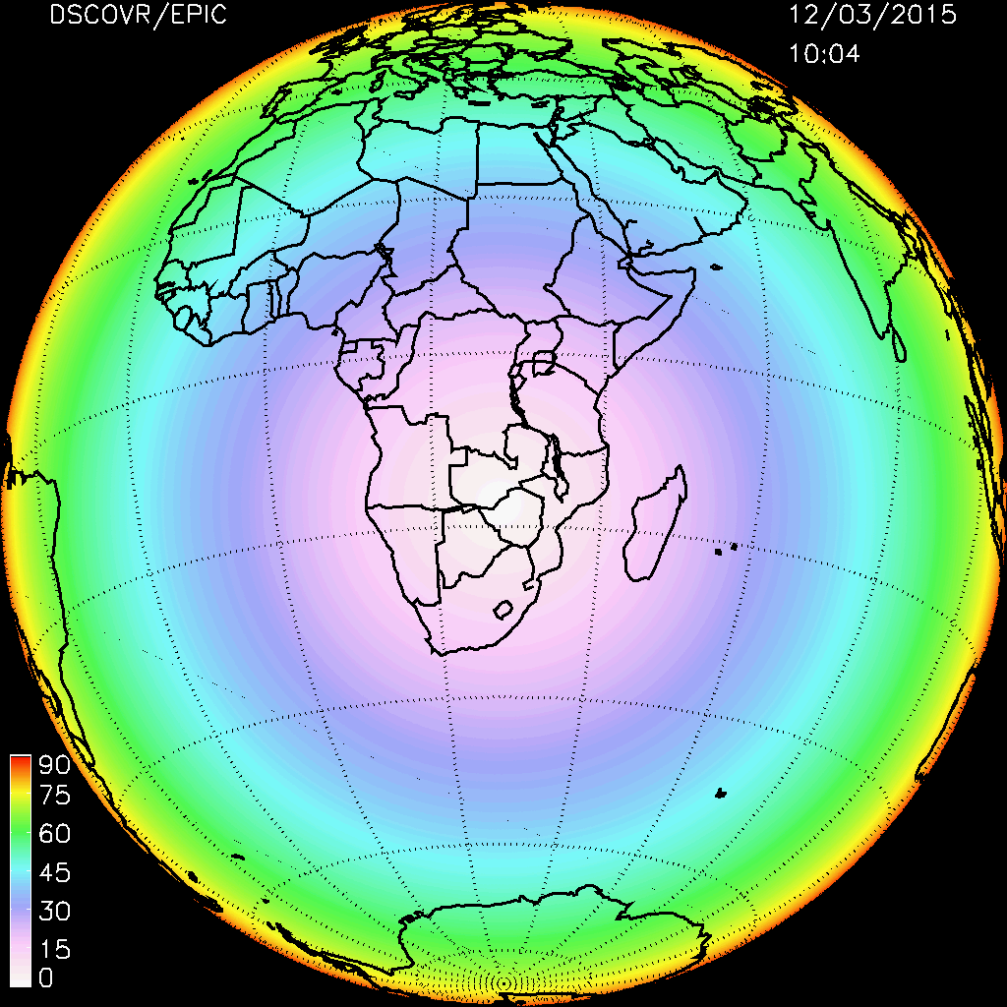
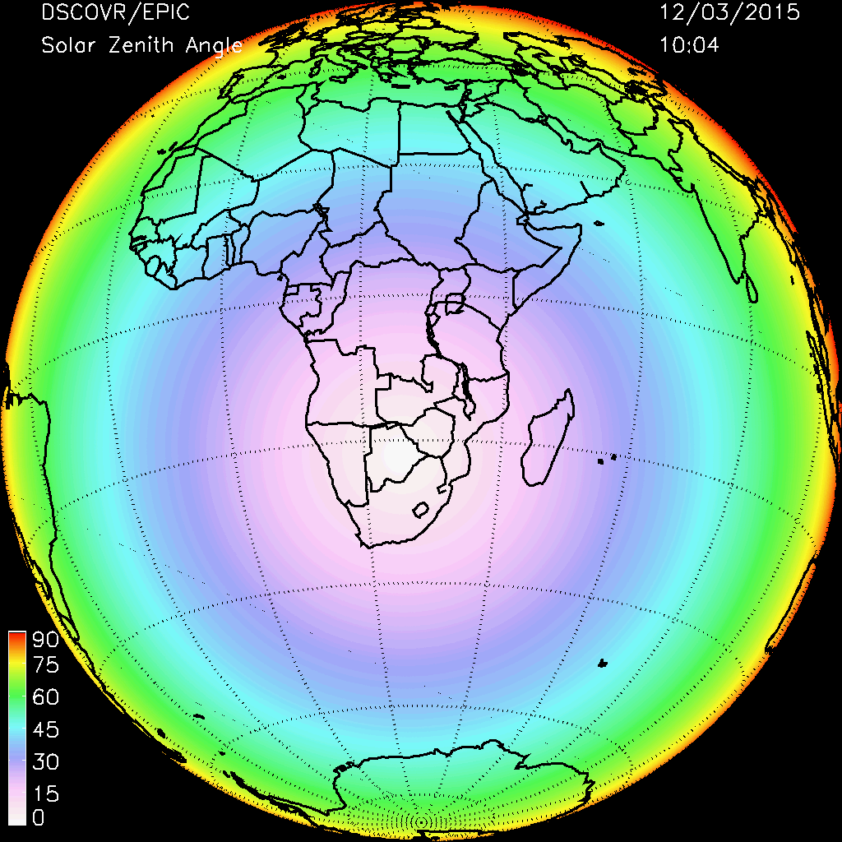
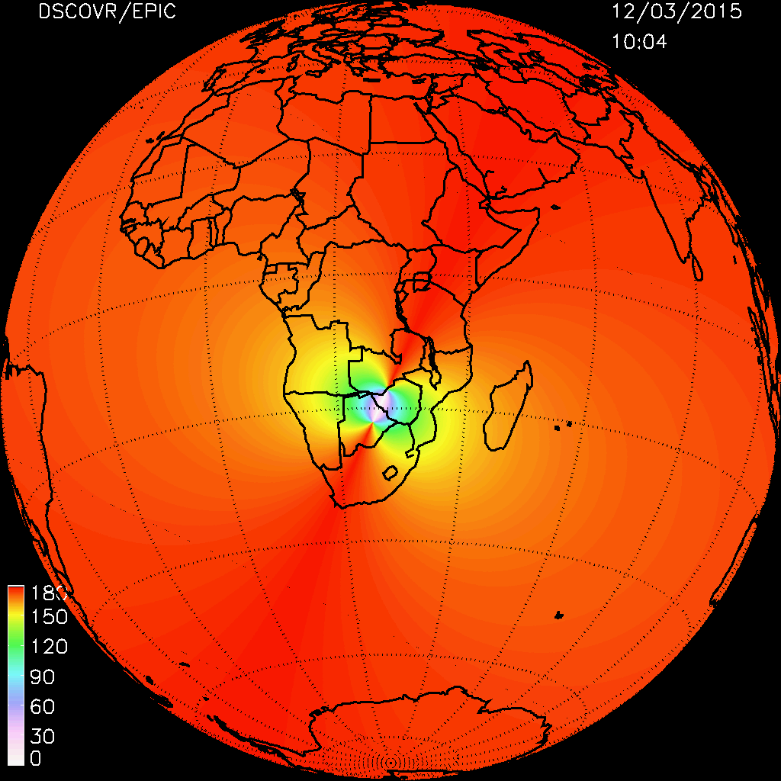
EPIC Viewing Geometry
Viewing Zenith Angle
Solar Zenith Angle
Relative Azimuth Angle

Slide 7
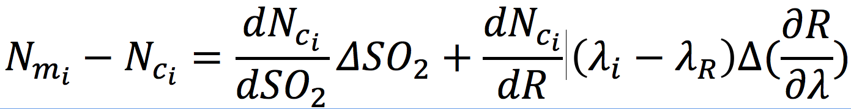
EPIC SO₂ Algorithm: Step 2
Step 2 reduces false positive and negative SO₂ artifacts due to spatial and temporal mismatch between 4 UV channels
that are not completely accounted for in Level 1B processing
N_{M}: Measured N= -100*log₁₀(I/F), N_{C}: Calculated N= -100*log₁₀ (I/F)
dN/dSO₂, dN/dR represent sensitivities of N vrt SO₂ and Reflectivity.
Use Step 1 retrieved quantities (SO₂, dR/dλ and R) as first guess
Apply 31 x 31 box smoothing to Step 1 O₃ to obtain a smoothed ozone field for full disc image. Use smoothed O₃ for calculating sensitivities dN/dSO₂ and dN/dR
Invert 2x2 K matrix to retrieve corrections Δx_{i}: ΔSO₂ and Δ(dR/dλ)
Update state vector by iteration, where x_{i}=x_{i-1}+∆x_{i}
Notes:
Description of the DSCOVR/EPIC SO2 Algorithm PI: Nick Kroktov
The DSCOVR/EPIC volcanic SO₂ algorithm is a modified version of the heritage NASA Total Ozone Mapping Spectrometer (TOMS) 4-band algorithm, adapted to the EPIC wavelengths. The algorithm uses all four EPIC UV channels (centered at 317nm, 325nm, 340 nm, 388nm) to retrieve 4 parameters of the state vector (x): vertical column amounts of SO₂ (assuming 13km height) and total O₃, the Lambertian equivalent reflectivity at 388 nm (R), and its spectral dependence, dR/dλ. The algorithm relies on spectral differences in SO₂ and O₃ absorption cross sections to separate the two trace gases. SO₂ is more absorbing than O₃ at the shortest UV channel (317 nm), whereas O₃ is more absorbing at the longer channel (325nm).
The retrieval is performed iteratively for each EPIC pixel with SZA < 75º. It starts with the climatological profile of O₃ and zero SO₂ and first computes Lambertian equivalent scene Reflectivity (LER) at 388 nm (R). This parameter remains fixed during the iterations. The algorithm then retrieves adjustments to the state vector: Δx =[ΔSO_{2,} ΔO₃, Δ(dR/dλ)] by matching measured and calculated sun-normalized backscatterd UV (BUV) radiances at shorter spectral channels (317,325 and 340nm). The sensitivities (Jacobians) associated with linear perturbations in SO₂, O₃ and R are pre-computed for each UV spectral band and stored in look-up tables, which are numerically interpolated for EPIC viewing geometry and state vector values at each iteration. This algorithm appears to have adequate sensitivity to detect moderate to large volcanic eruptions from L1 Lagrange point.
Max iterations = 3
Quit itrations when Min res325 = 0.001 ( N value)

Slide 8
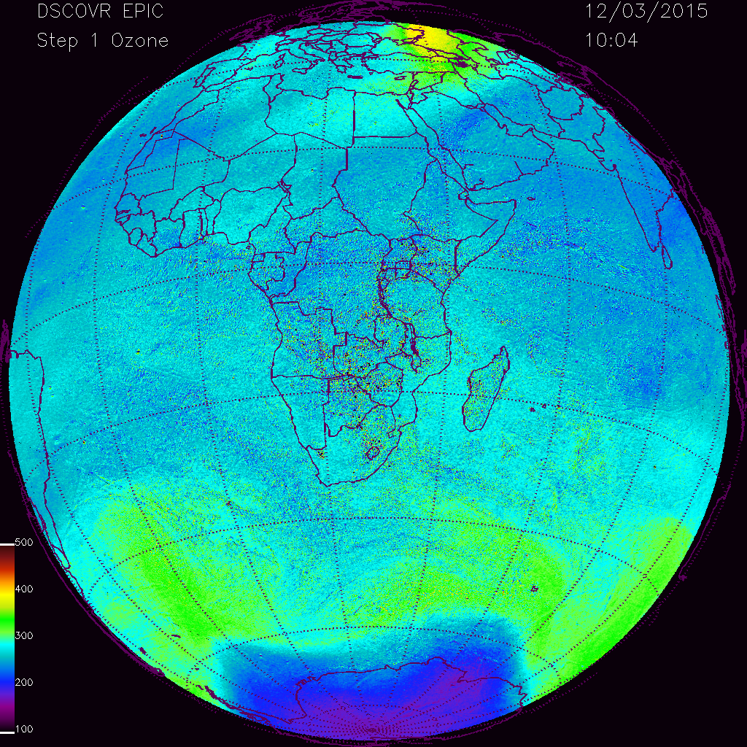
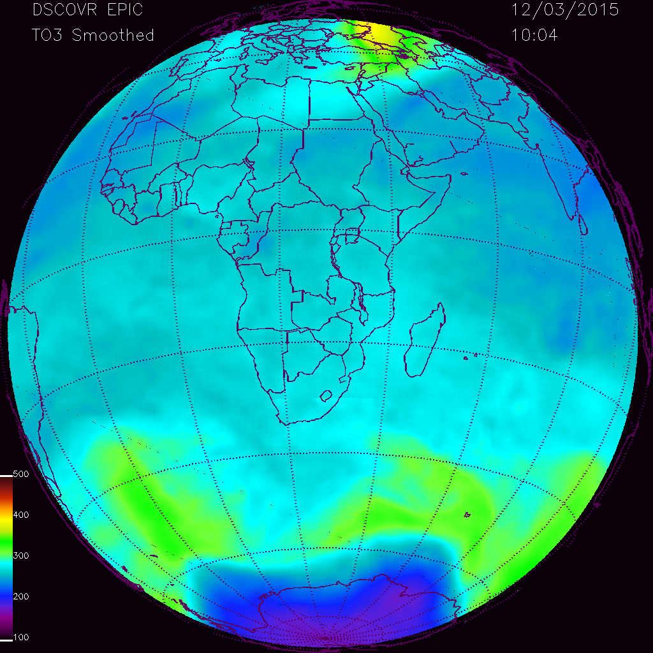
EPIC SO₂ diagnostic: Ozone
Total Column Ozone
Step 1
Total Column Ozone
Step 2: Smoothed

Slide 9
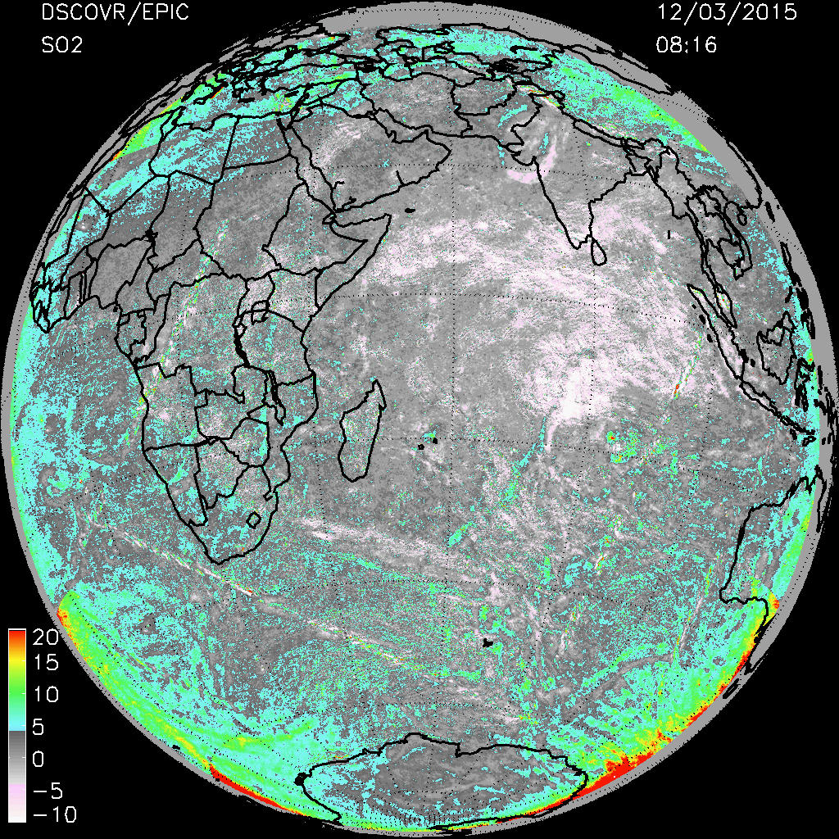
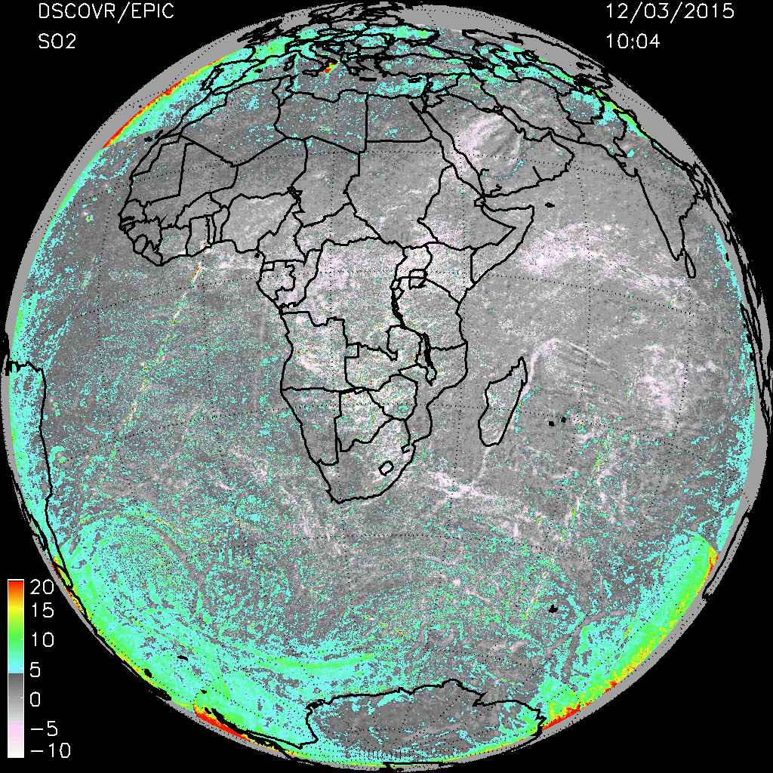
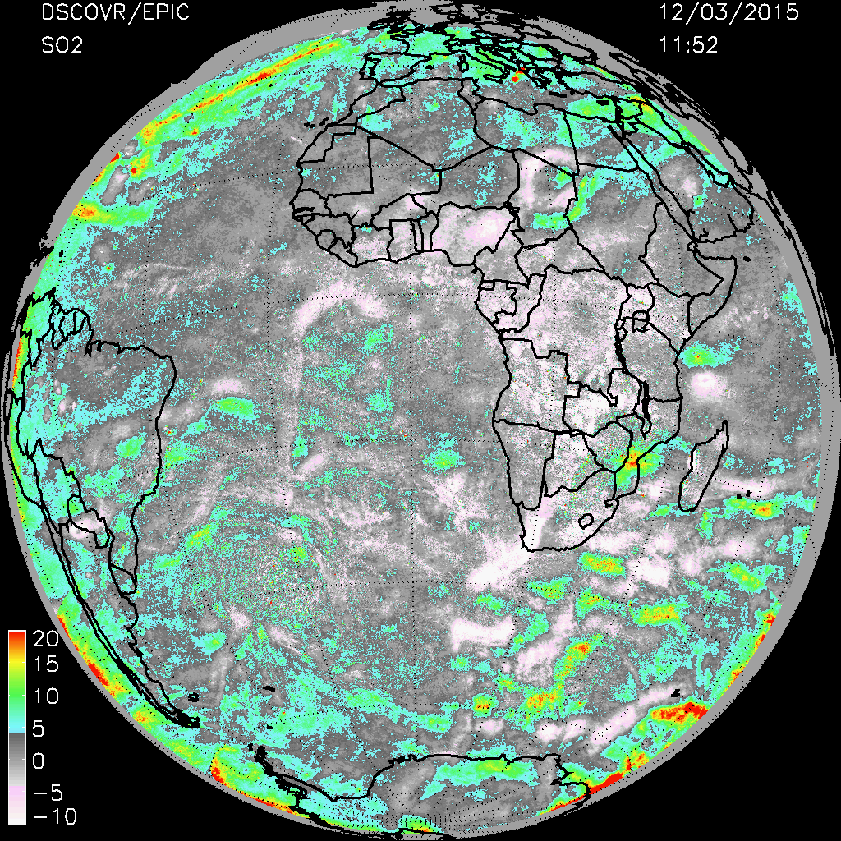
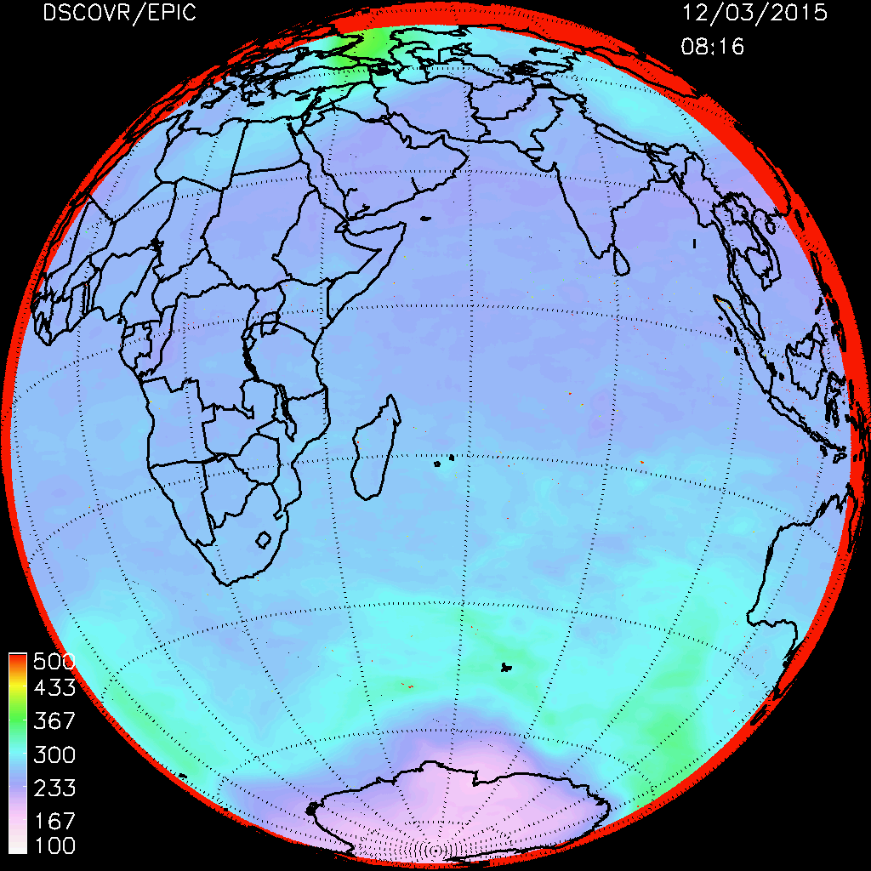
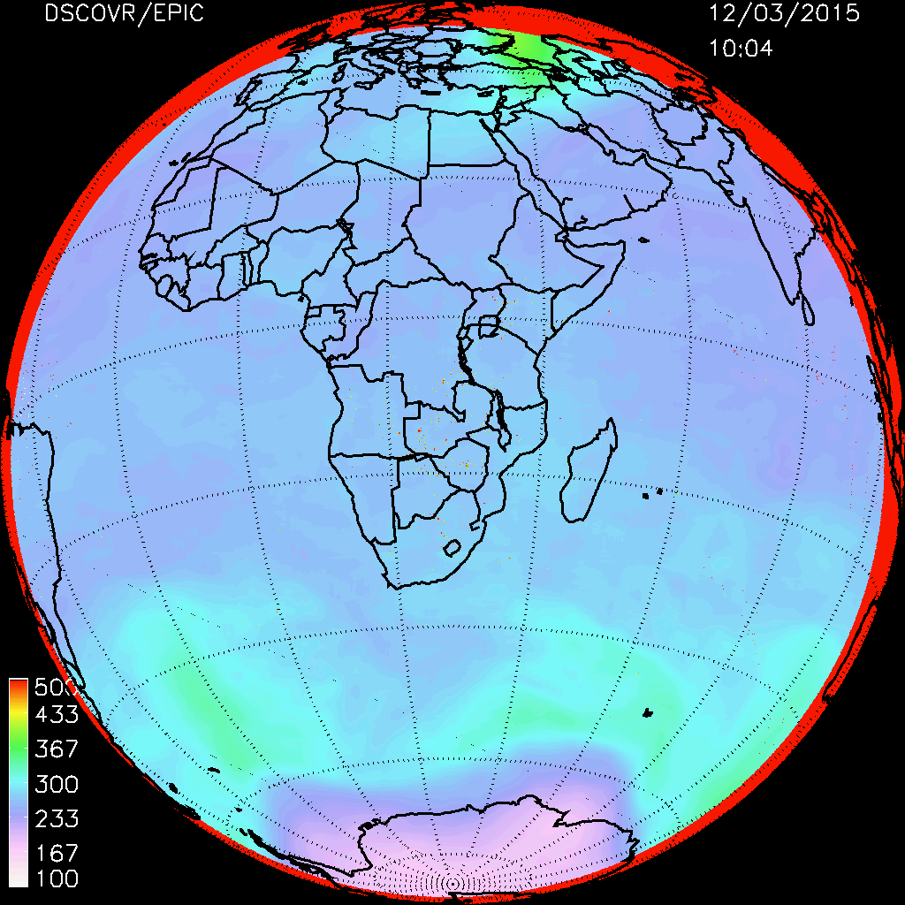
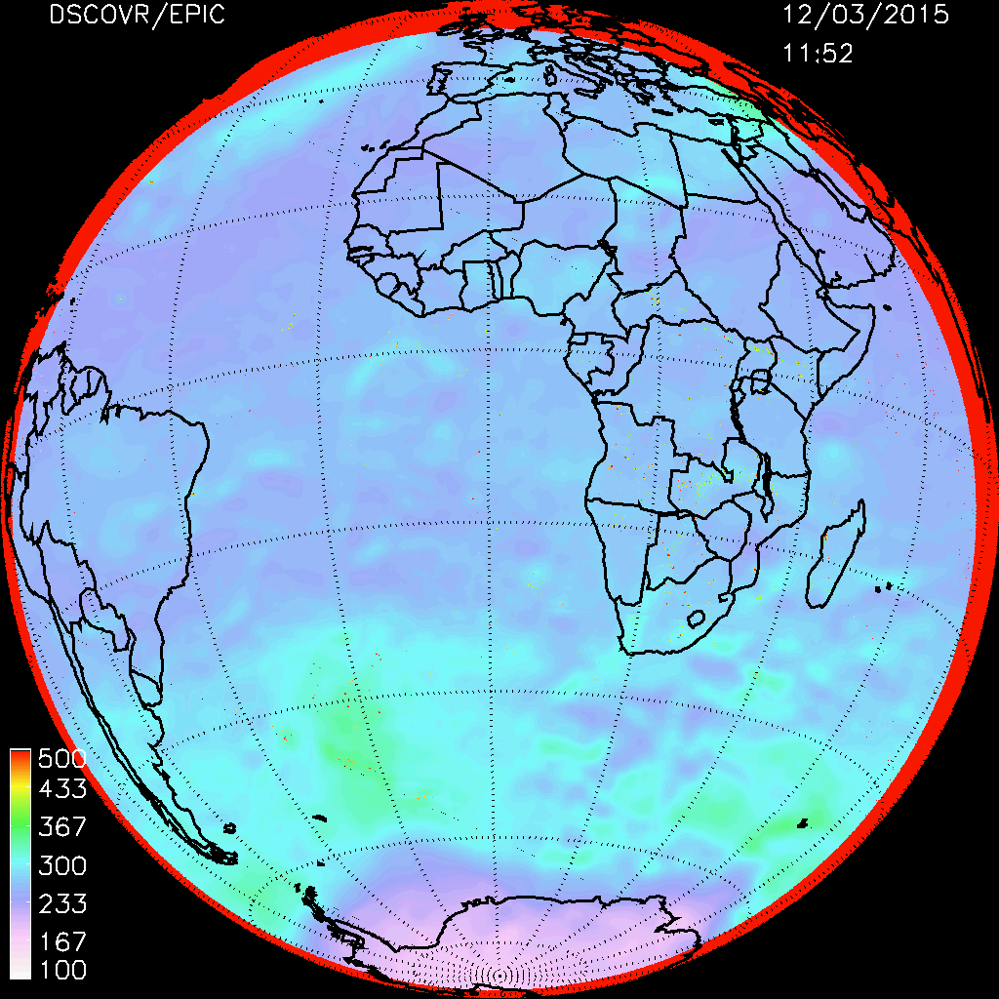
EPIC SO₂ diagnostic
SO₂
O₃ Smoothed
SO₂

Slide 10



EPIC SO₂ diagnostic: Step 1 and Step 2 O₃
O₃ Step 1
O₃ Step 2

Slide 11
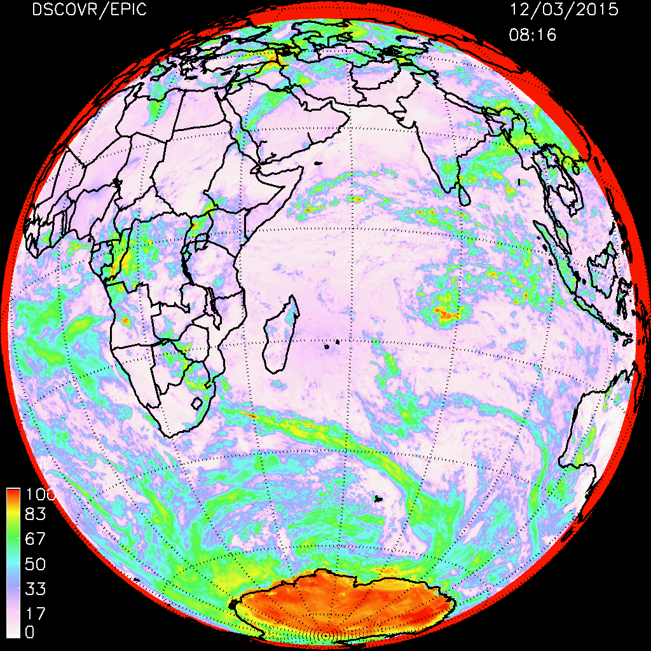
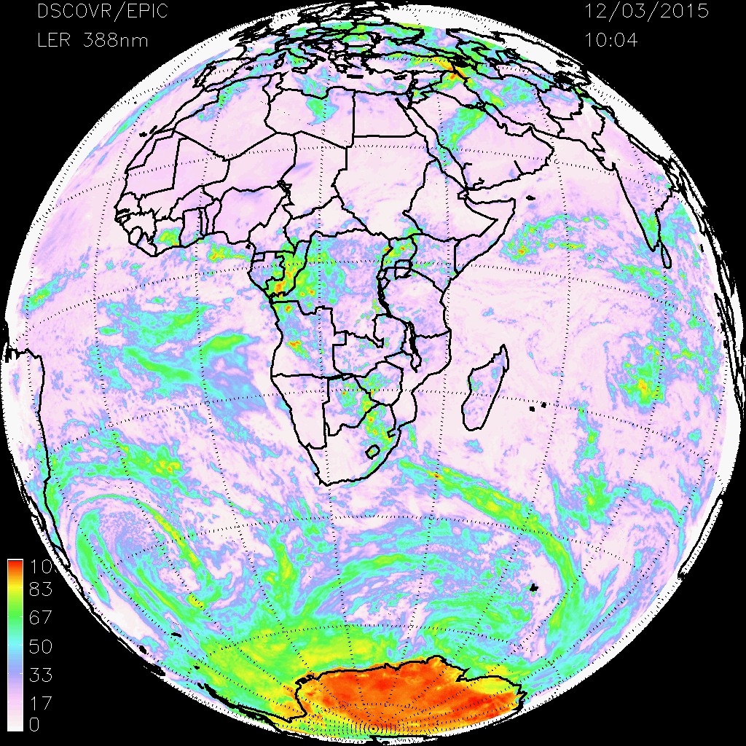
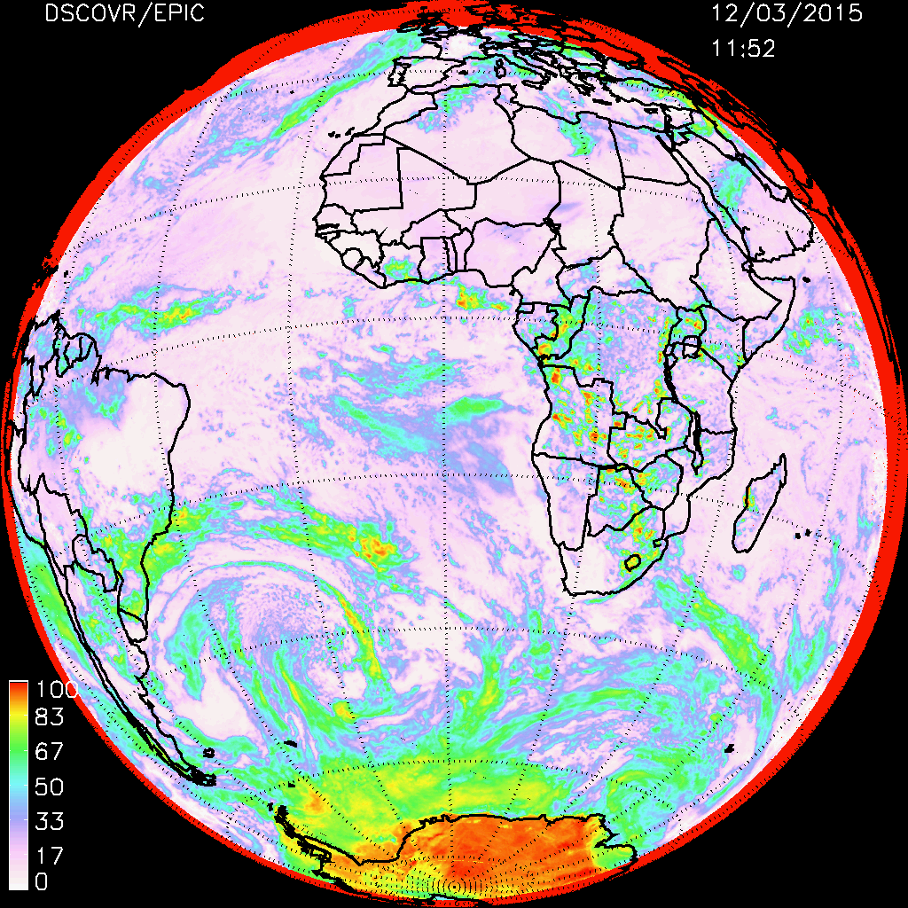
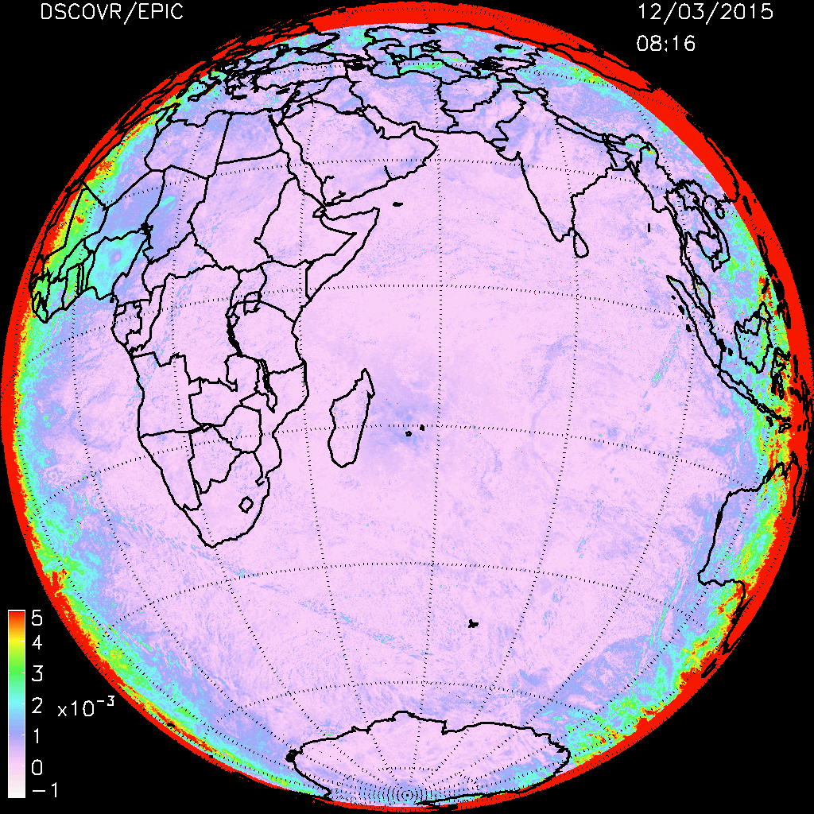
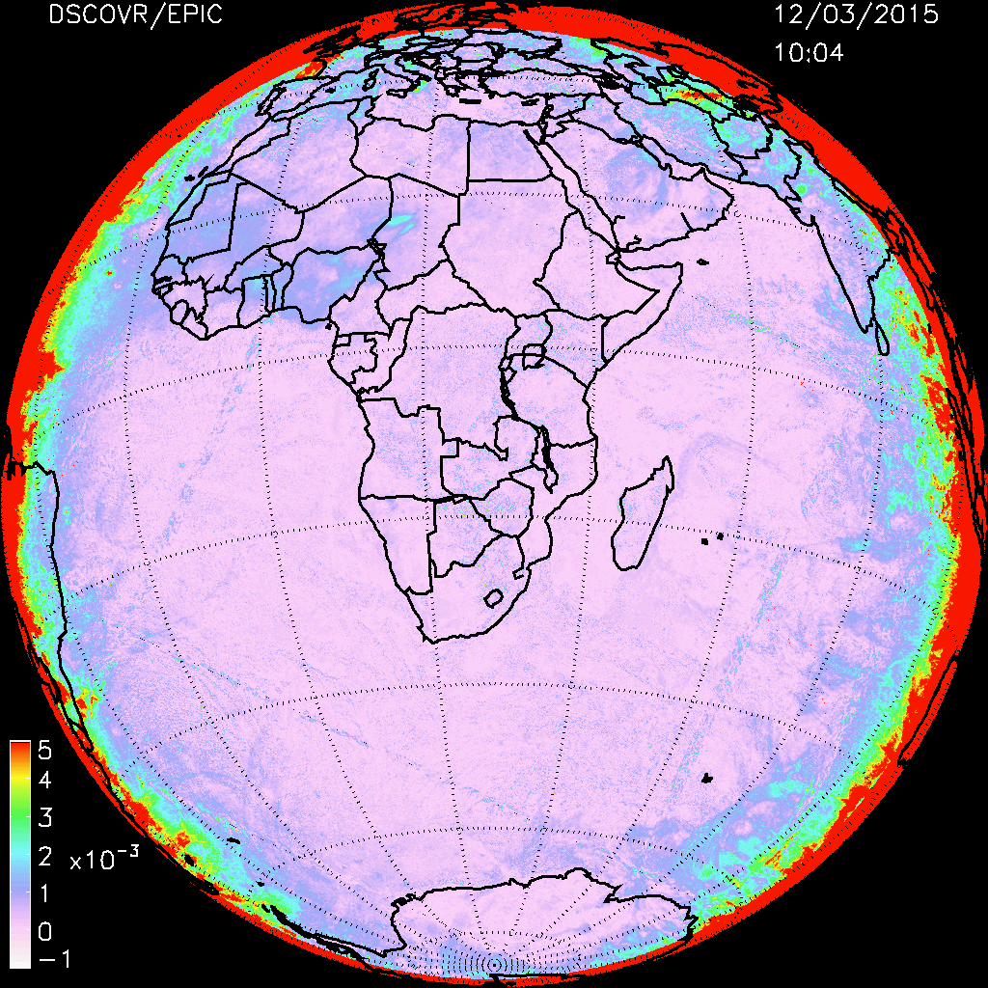
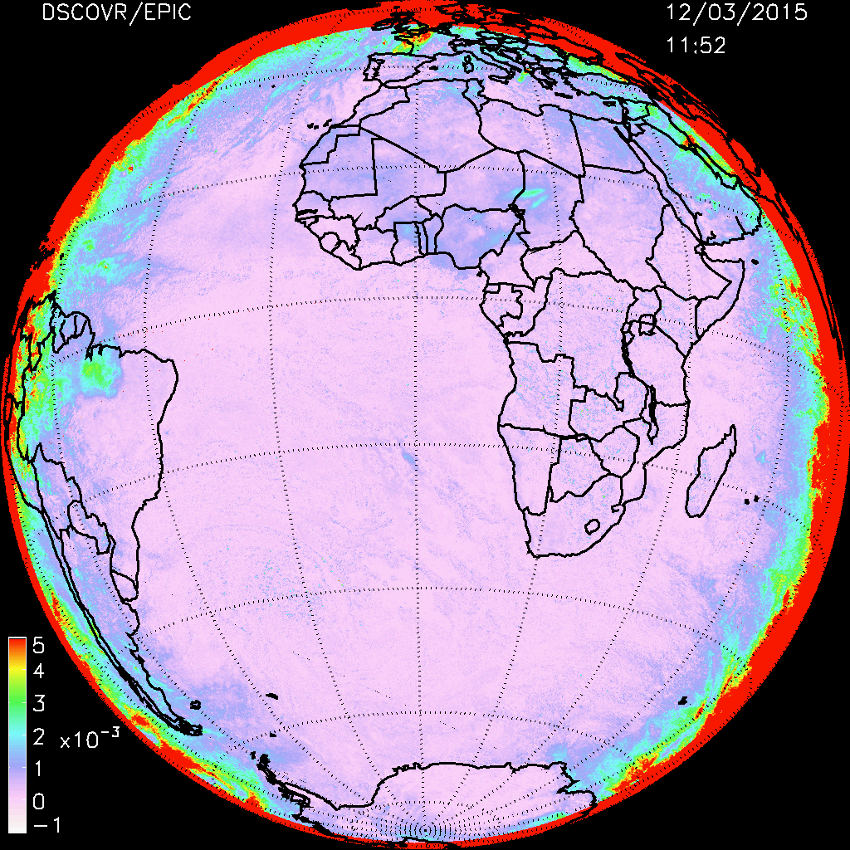
EPIC SO₂ diagnostic: LER(R) and dR/d𝜆
LER
dR/d𝜆
(x10⁻³)

Slide 12
EPIC shows SO₂ Volcanic Plume Evolution

Slide 13
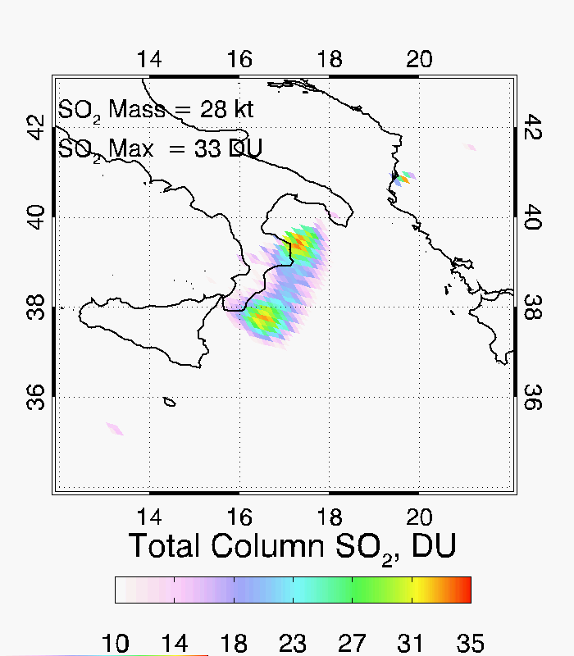
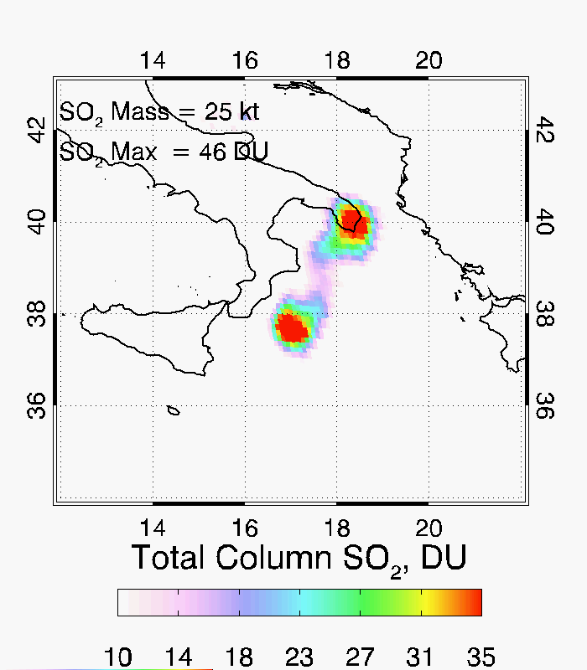
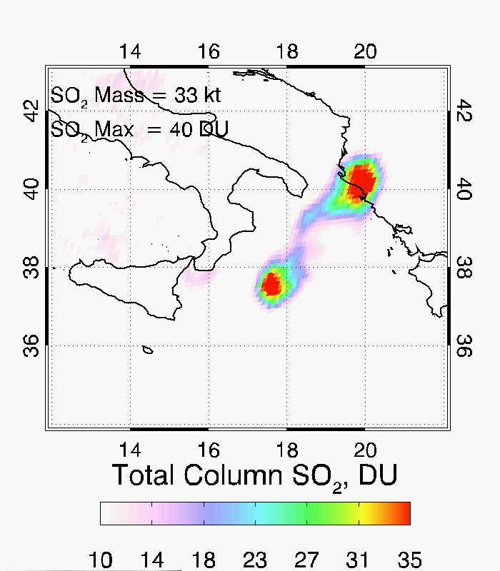
Mount Etna, Italy Eruption
December 3, 2015
08:16 UTC
10:04 UTC
11:52 UTC

Slide 14
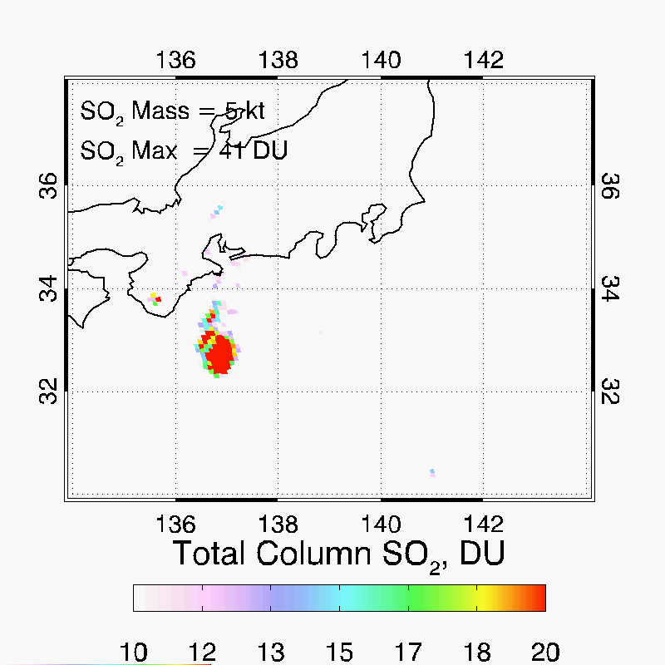
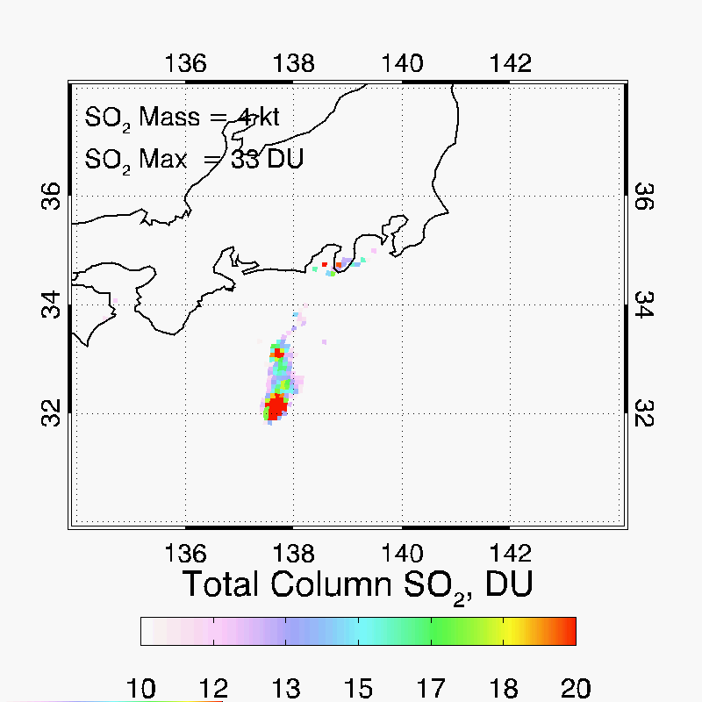
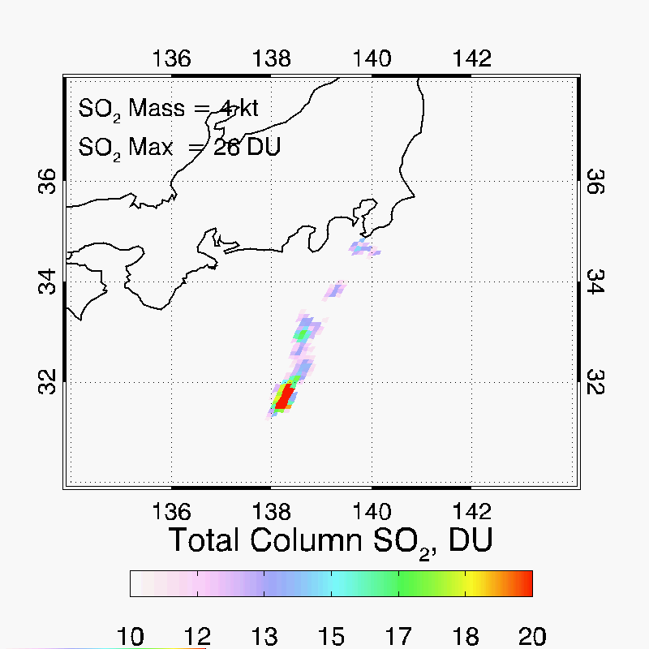
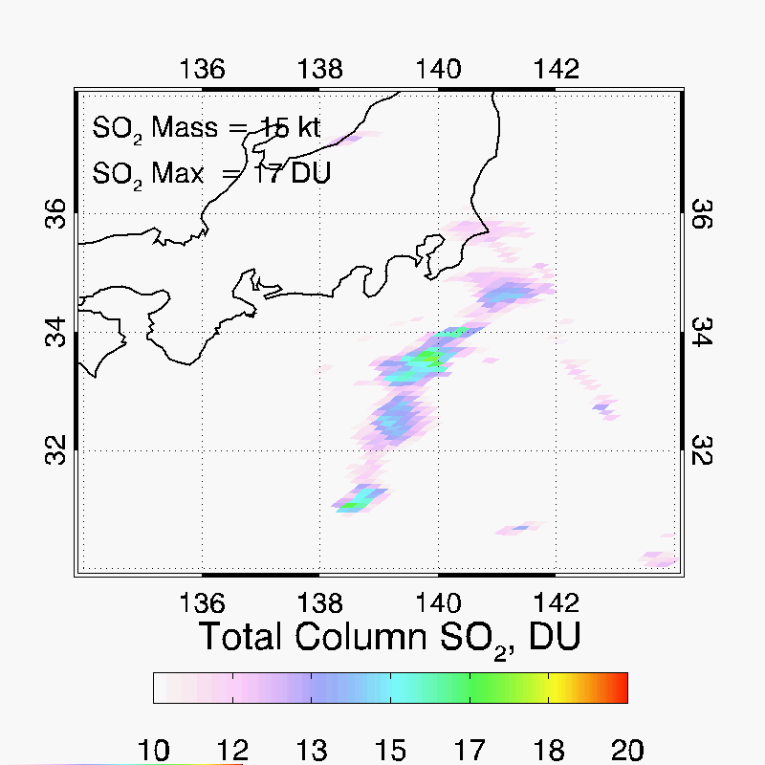
Mount Aso Eruption 10/08/2016
00:55
02:43
04:31
06:19

Slide 15
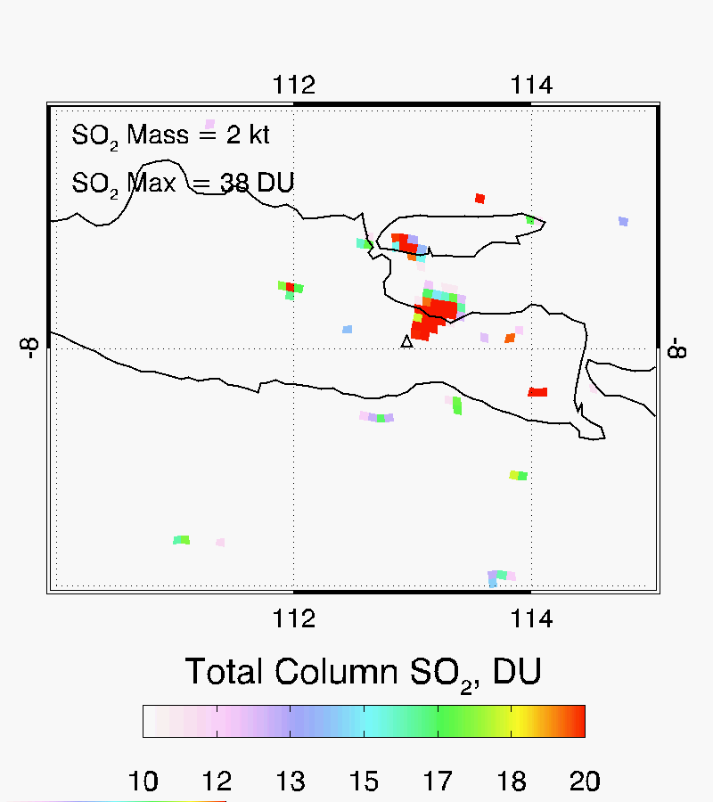
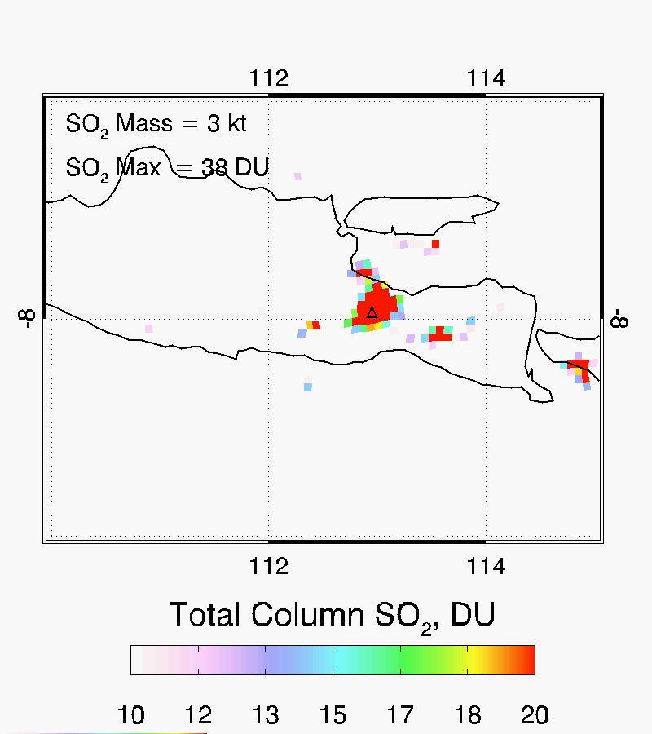
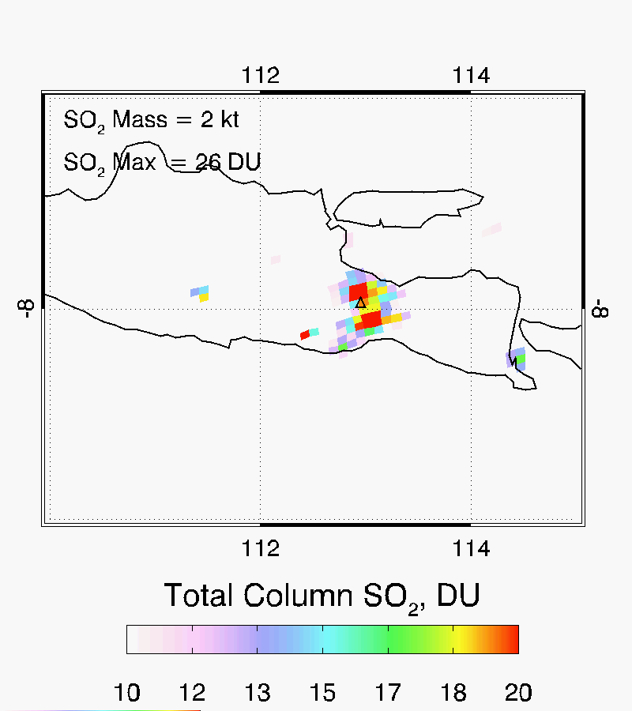
Mount Bromo, Java
January 2, 2016
04:12
06:00
07:48

Slide 16
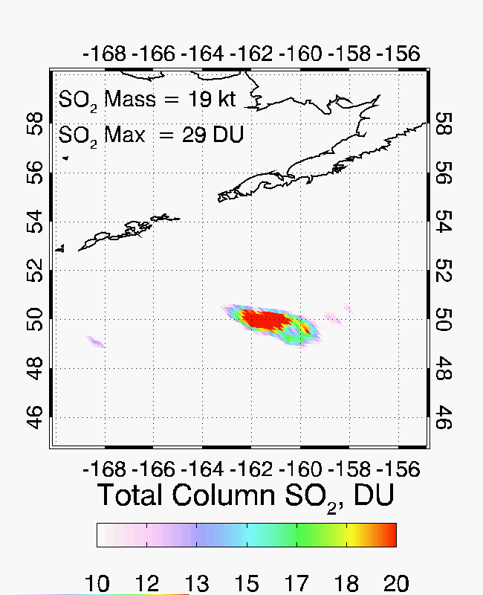
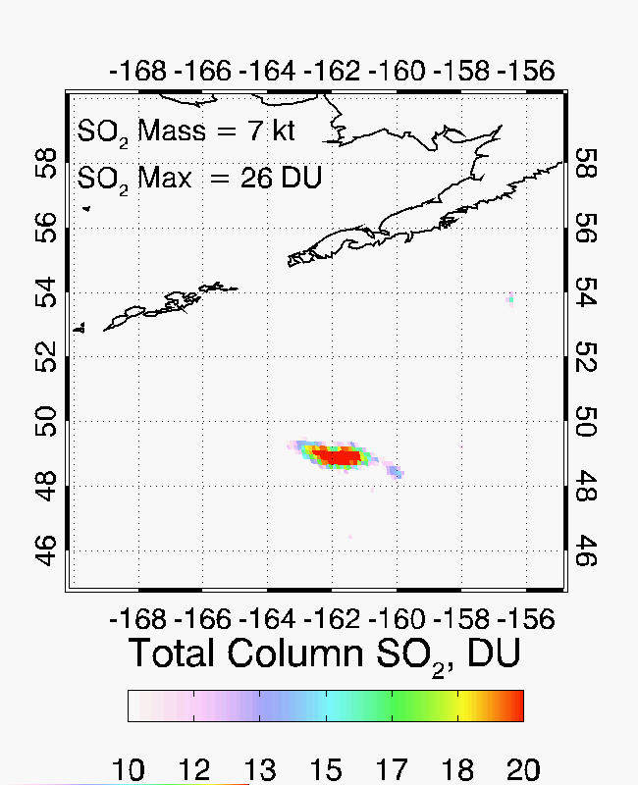
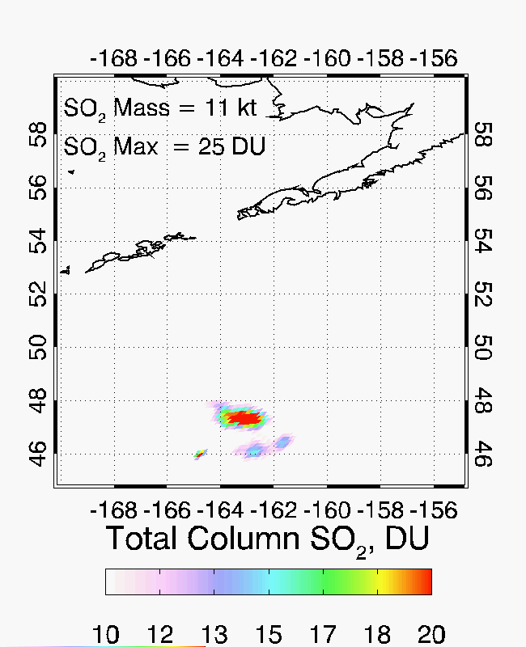
Mt. Bogoslof Eruption
March 8-9 2017
20:15
22:03
00:45

Slide 17
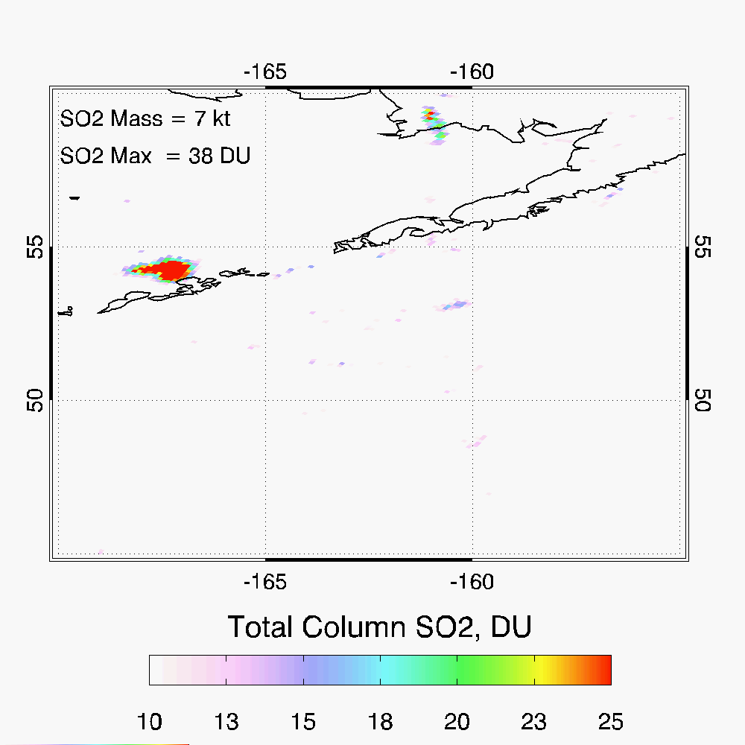
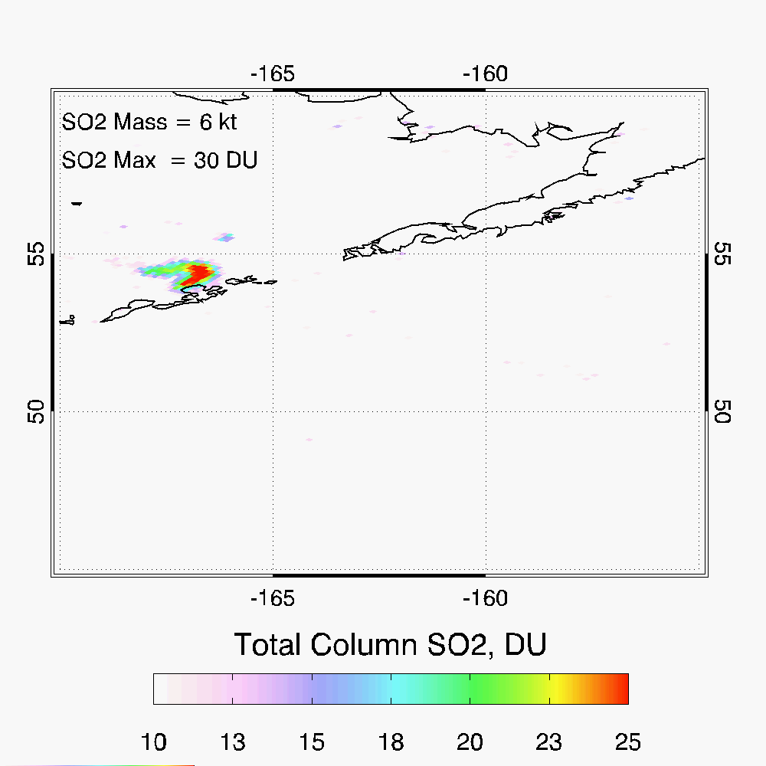
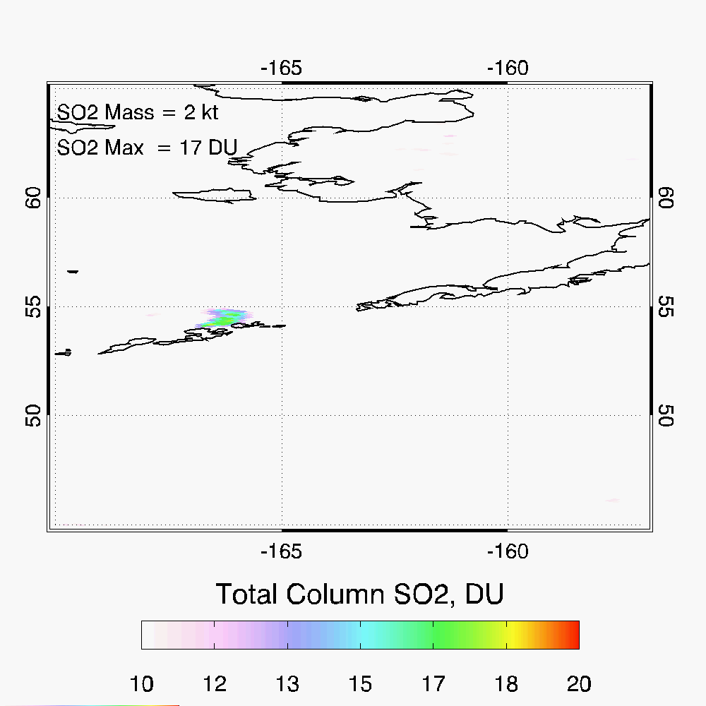
Bogoslof Eruption
May 29, 2017
01:23
02:28
03:34

Slide 18
Comparisons with OMI and OMPS

Slide 19
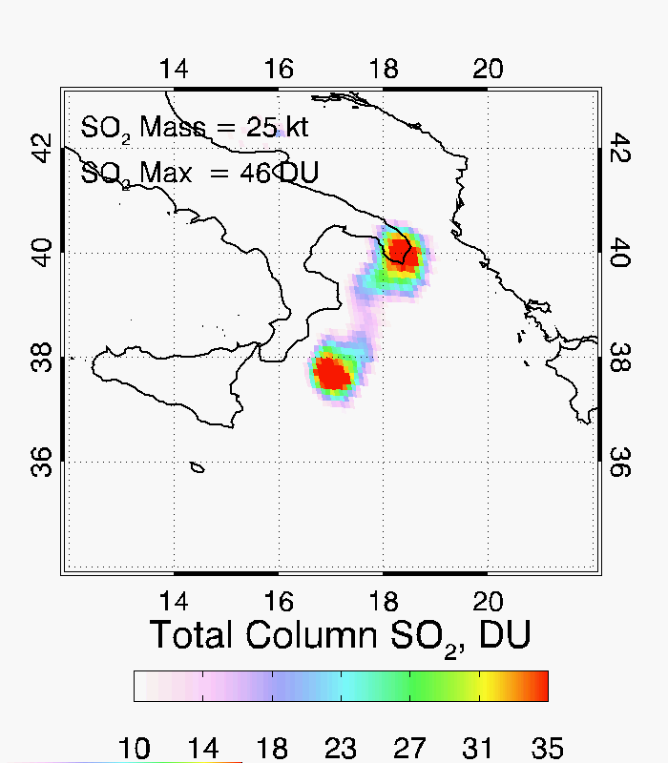
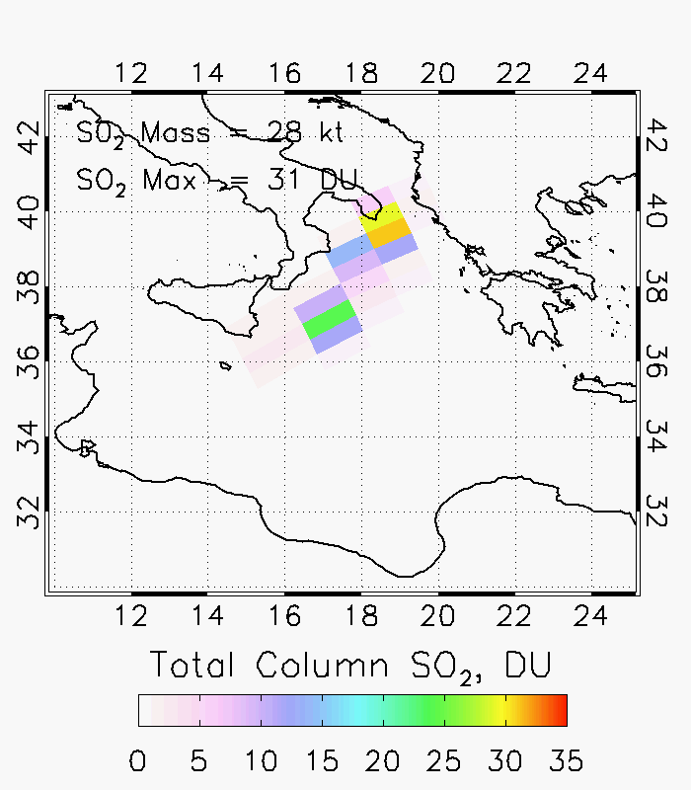
Mt Etna, Italy
December 3, 2015
DSCOVR/EPIC
10:04
OMPS TRU
11:05

Slide 20
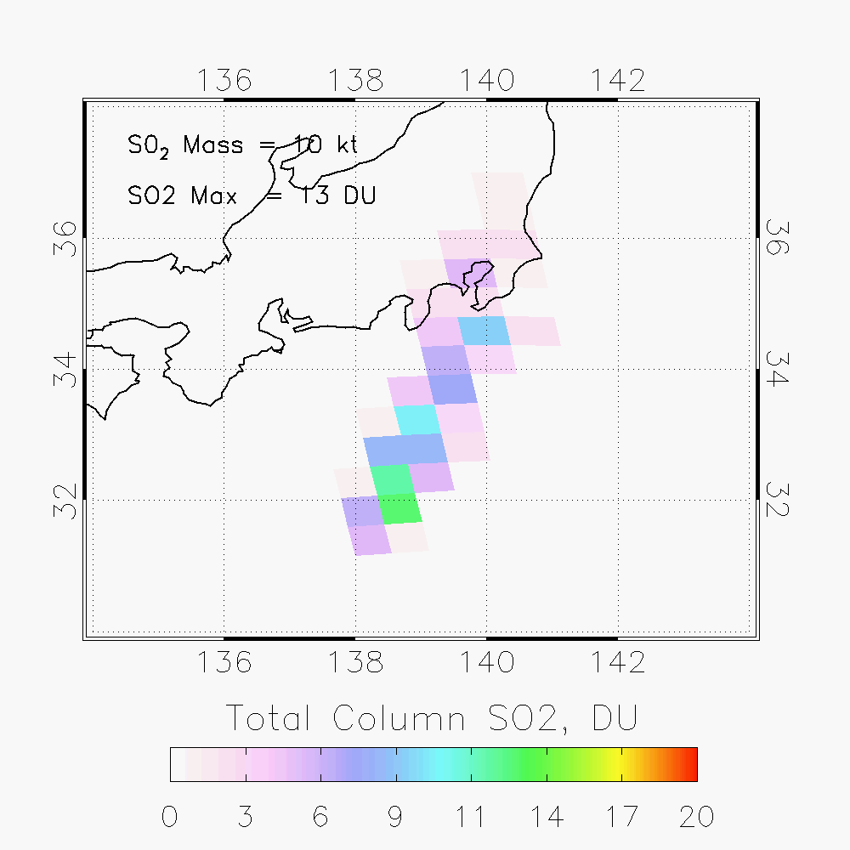
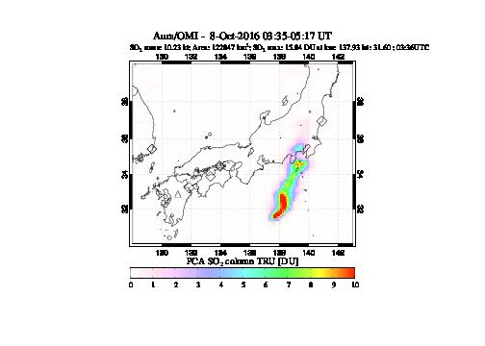
Mount Aso, Japan
October 8, 2016
DSCOVR/EPIC
Aura/OMI
Suomi-NPP/OMPS
Not the same scale

Slide 21
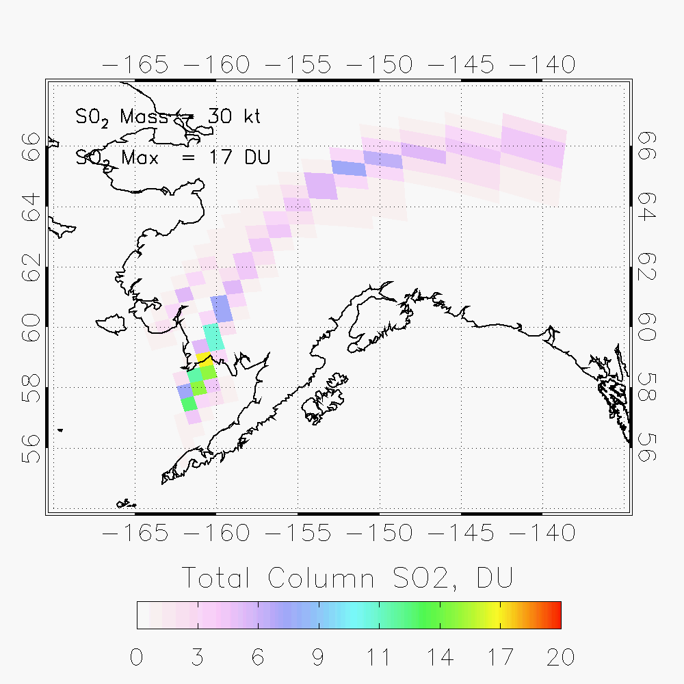
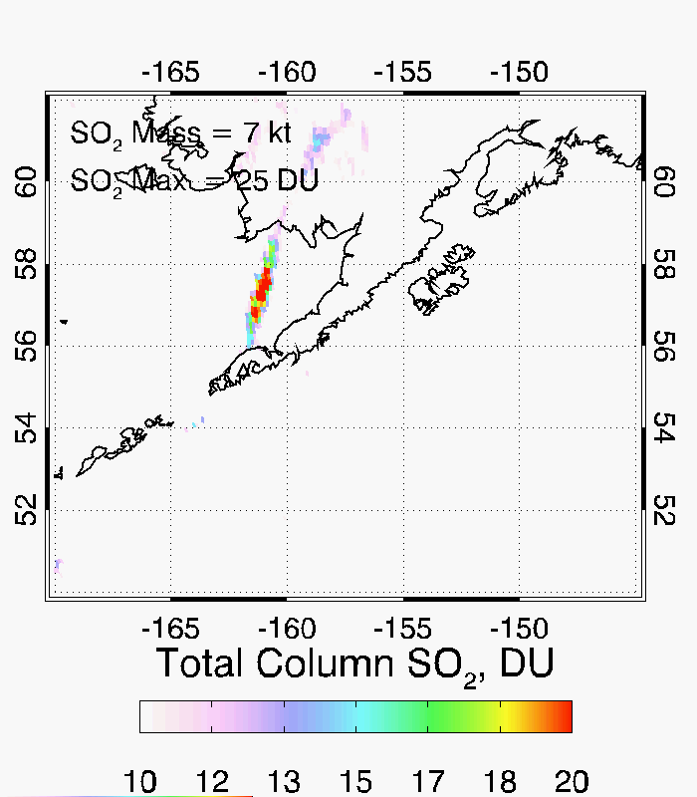
Pavlof eruption, Alaska
March 28 2016

Slide 22
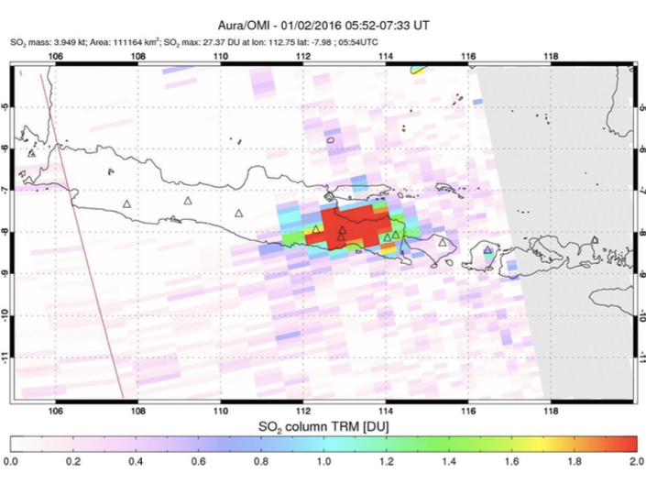
Mount Bromo, Java
January 2, 2016
DSCOVR/EPIC
07:48
Aura/OMI
05:52-07:33
SO2 Mass = 3.9
SO2 Max = 27.3

Slide 23
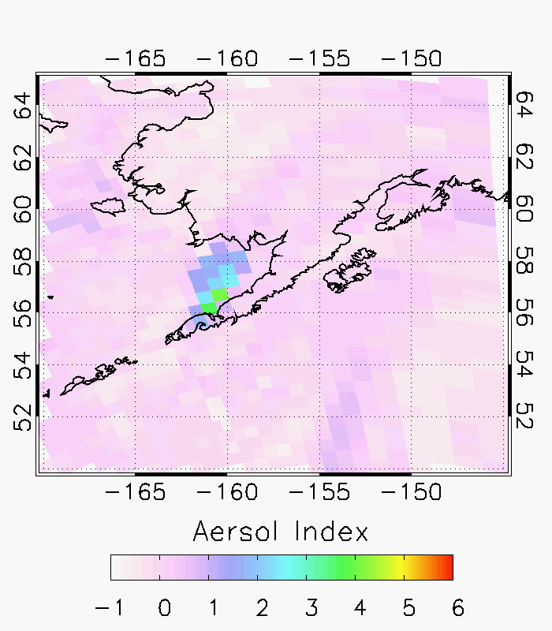
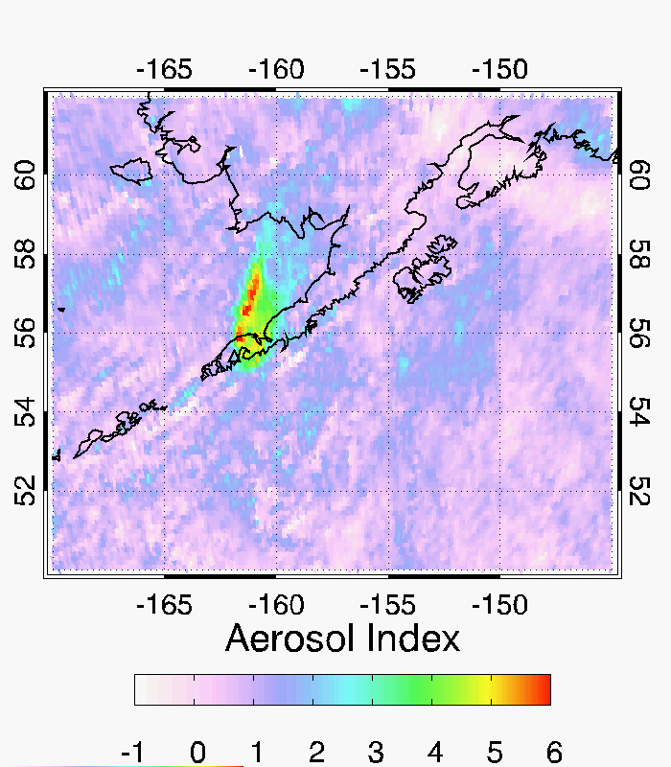
March 28 2016 Pavlof eruption: Ash Index
OMPS AI
EPIC AI

Slide 24
L1B Issues
Correlated Structures observed in SO₂ background
Quasi-climatic structures observed possibly associated with clouds (e.g., southern hemisphere near

Slide 25
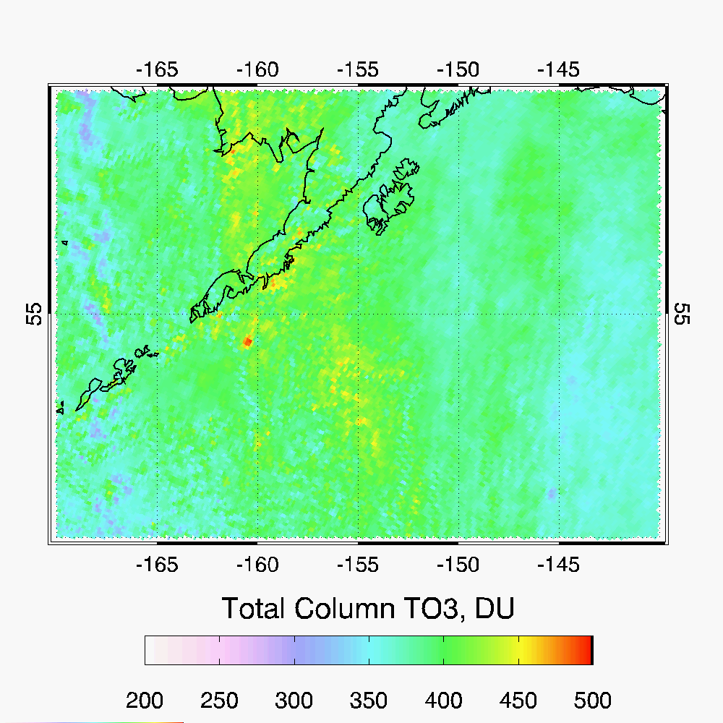
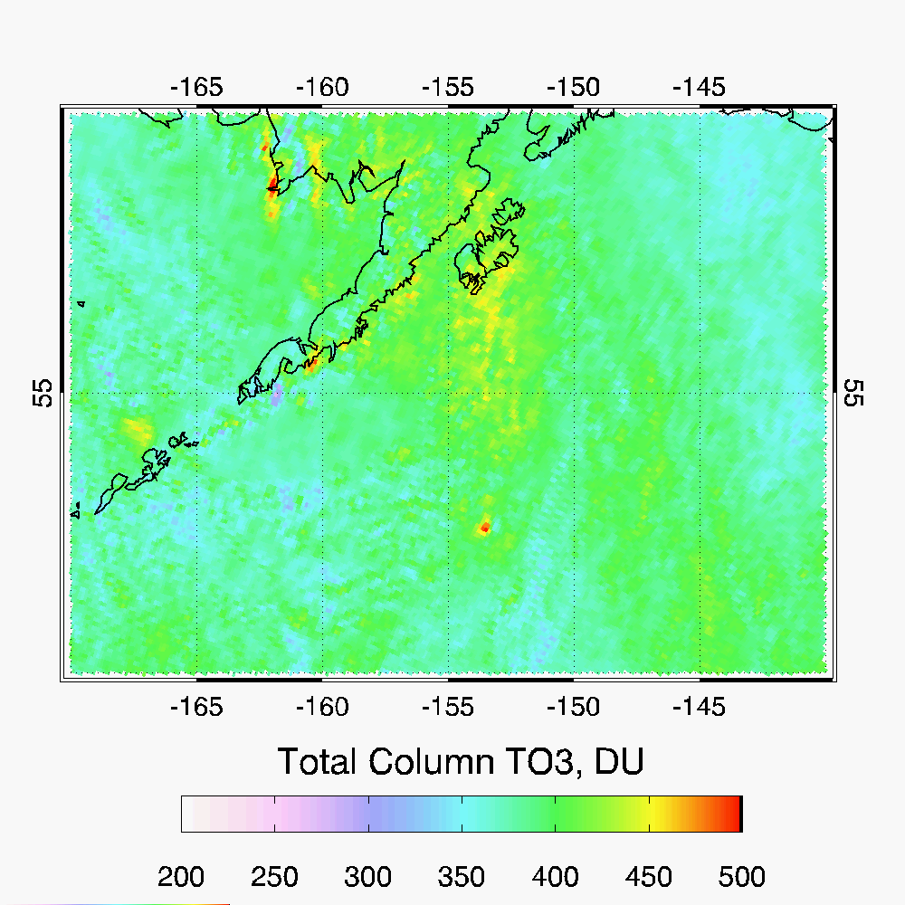
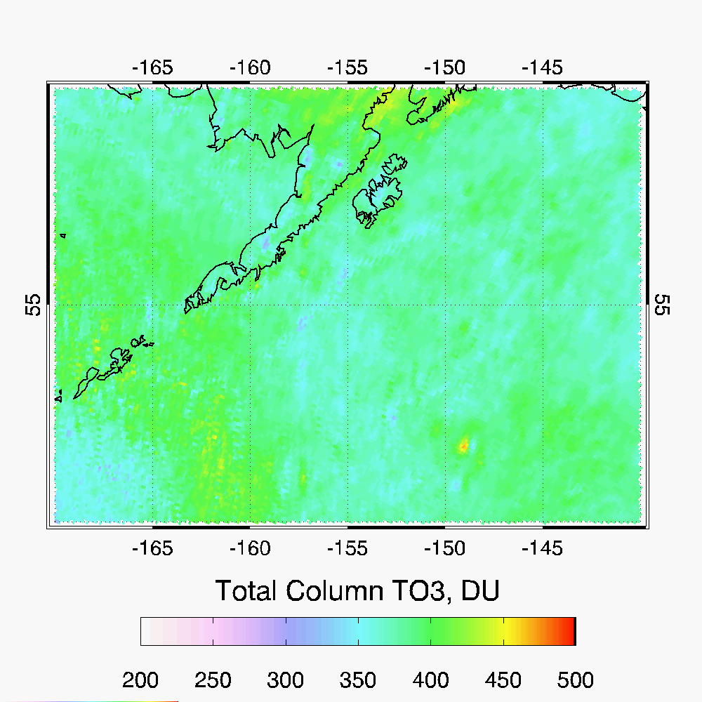
Step 1 O₃ high intensity spot occurs on 3 images observed about the same time 1-day apart
05-28-2017 01:42
05-29-2017 01:23
05-30-2017 01:13

Slide 26
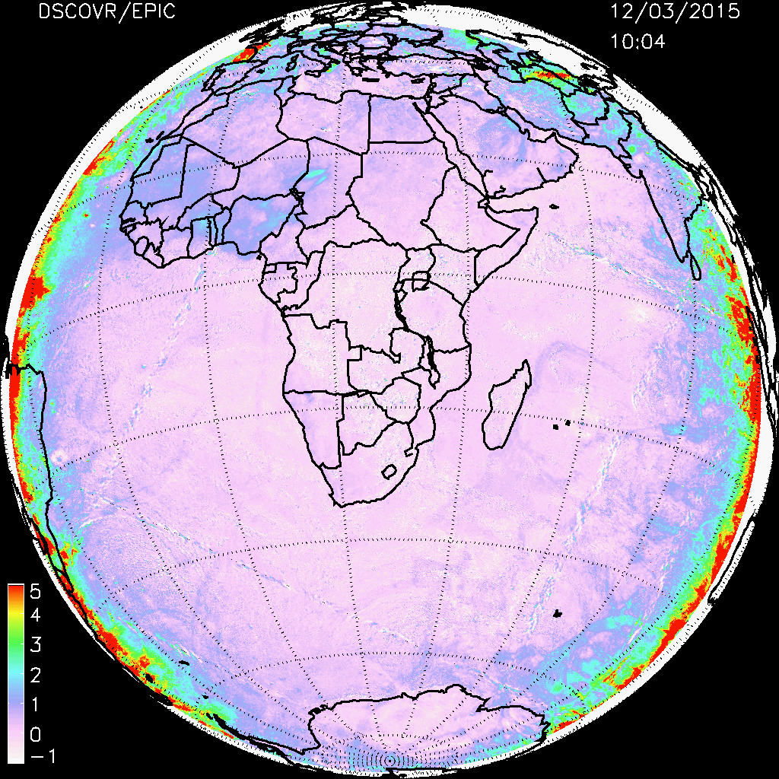
High bias around Earth Limb…. ?

Slide 27
Product Status
Delivered source code to NCCS processing
Provided Marshall with list of volcanic cases for processing
Delivered product description and L2 data sample to Marshall
Working on ATBD draft. Deliver by the end of 2017
Working on journal publication of SO₂ results from EPIC
Two abstracts submitted to 2017 Fall AGU meeting (EPIC session)

Slide 28
Next steps
Deliver volcanic SO₂ data and metadata to Langley ACDS
Improve retrievals for bright cloudy scenes
Adding more SZA and VZA nodes to LUTs
Improve retrievals for near Limb
Need continue EPIC operations to see larger volcanic plumes
Agung , Indonesia - ?

